Slide 1



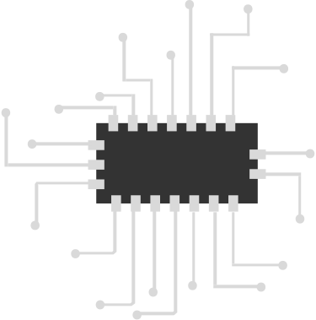

Water Level Indicator

Slide 2


About:
Electronic Equipment
Sensing Device
Gives level indication at three stages
LEDs at two and buzzes at third

Slide 3

Components Used
3 BJT Transistors-BC547
3 100 Ohm Resistors
Blue and Green LEDs
Buzzer
9V Battery
Connecting Wires
Water Tank
Breadboard

Slide 4

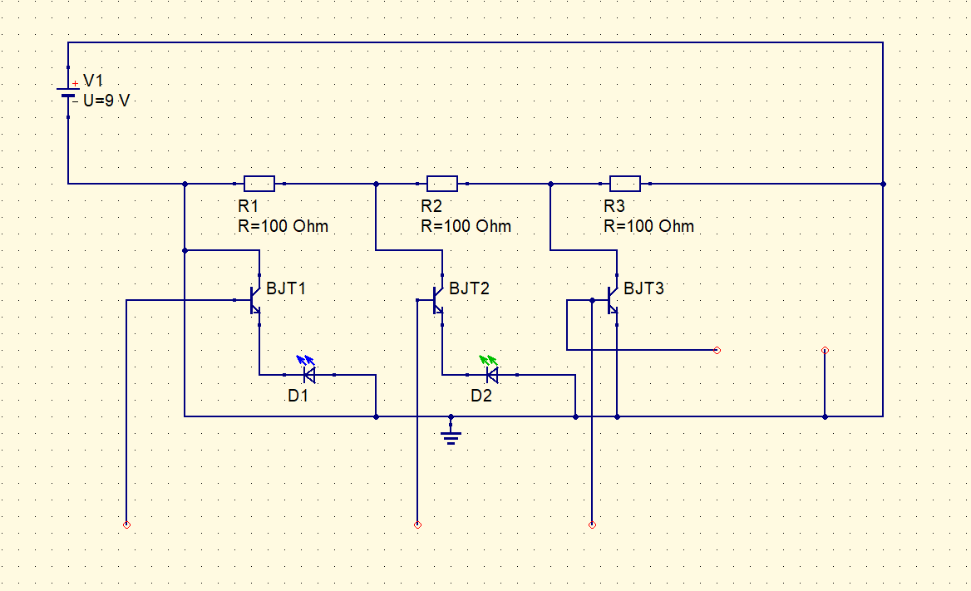

Circuit:
Buzzer
Water tank

Slide 5


Uses
Borewells
Underground and Overhead tanks
Dams
Factories
Chemical & Electrical Plants

Slide 6
Thank You

